Slide 1
USMC Sports Medicine
Injury Prevention Program
(SMIP)
Information Brief

Slide 2
Purpose/End State
BLUF
Purpose
  To provide an overview on the USMC SMIP program and CMC intent
End State
  Understanding of the role of SMIP in support of USMC mission and CMC intent
BLUF
  SMIP supports USMC mission by reducing attrition and lost training days associated with musculoskeletal injuries.
  SMIP is a collaborative USMC and USN effort
  The Commandant has directed expansion of the SMIP program to the operating forces by placing civilian Certified Athletic Trainers in Regiments and Groups.

Slide 3
SMIP Information Brief
CMC Guidance
Background
Vision and Strategy
Entry Level Training implementation
Injury Prevention and Treatment Continuum
SMIP Effectiveness Data
Current locations of Athletic Trainers in TECOM
SMIP Policy
SMIP Expansion to Operating Forces
Planned locations for Athletic Trainers
Discussion

Slide 4
CMC Guidance
From 24 July 2017 CMC email: “Would like for TECOM and HS to cost out the
requirement have contracted Athletic Trainers every Regiment/Group and to
increase our numbers at MCRDs and SOIs... spend money to save money/reduce
injuries/recover faster.”
From 2 Aug 2017 CMC IPR: “We’ll find money for this.”
COAs ranging from 45 AT’s to >60 Corps-wide have been provided to CMC and P&R
for consideration.
Site visits to I MEF (14-16 Nov), II MEF (29-30 Nov) and III MEF (14-19 Dec) ISO implementation
3

Slide 5
SMIP Background
Universal Needs Statement, Dec 2001
ACMC directed pilot
Health Services initially in lead, CG TECOM assigned Pilot Program Sponsor May 2002
Ltr from CG MCCDC to Navy Surgeon General (SG) formally seeking support/alignment (Sports Med Physicians) ISO SMIP Dec 2002
  Sports Med Physicians to MCRDs, SOIs, OCS and TBS
Athletic Trainers in place June 2003
MOA b/t Navy Surgeon General and CG TECOM signed Oct 2007
  USMC Funds/leads, Navy aligns
  Navy SG recognizes National Athletic Trainers Association (NATA) Standards of Practice
TECOMO 6260 w CH1 “SMIP” Nov 2008 provides CG TECOM Commander’s Intent and Major Subordinate Command/TECOM Staff responsibilities
  Centralized TECOM Program Management / Decentralized Execution

Slide 6
Vision and Strategy
Vision
Increase readiness by reducing attrition and lost work-days associated with musculoskeletal injuries.
Strategy
Balance injury prevention, initial evaluation, treatment, and return to readiness.
  Conduct quality injury surveillance.
  Exploit existing capabilities.
  Identify resources necessary to fill gaps.
Incremental, adaptable, sustainable approach.
Complement (v. replace) existing Navy Medicine capabilities.
Treat Marines as Warrior Athletes.

Slide 7
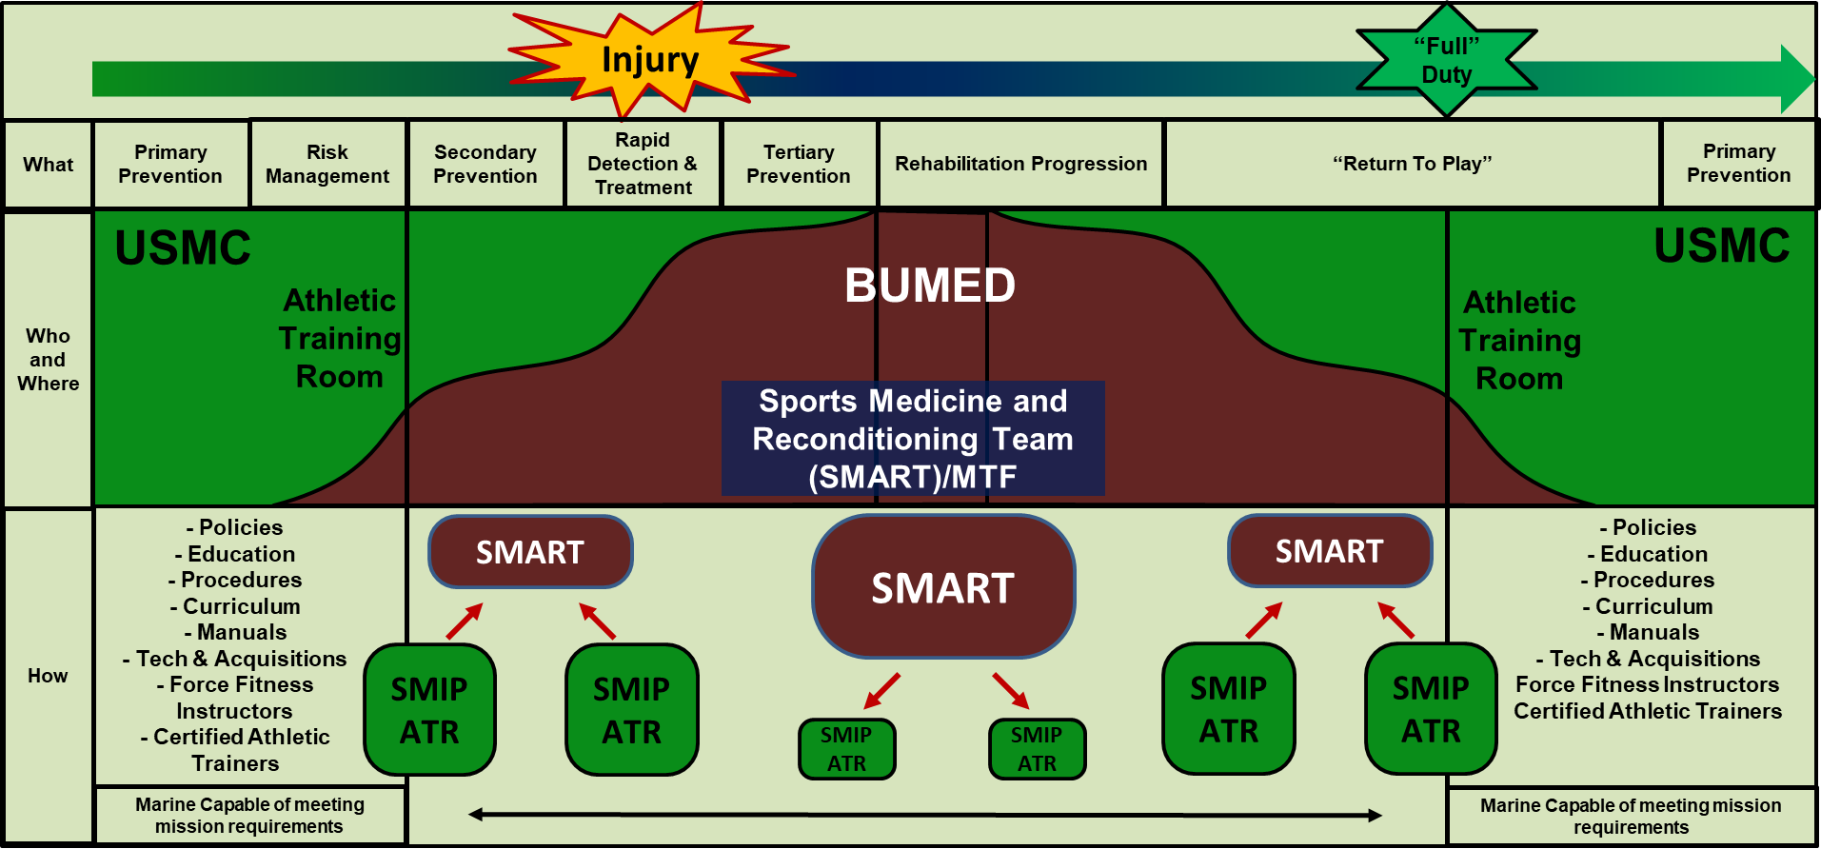
Prevention / Treatment Continuum

Slide 8
Entry Level Training Implementation
Selected based on large, vulnerable population, cumulative experience and standardized procedures.
Certified Athletic Trainers
  Civilians who are employees of assigned USMC commands (S-3s). GREEN ASSETS (NCAA model)
  Currently 21X GS, 7X Contracts
  Navy Sports Med MDs provide medical oversight when dealing with injuries
  Emphasis on injury prevention, education, and treatment
Initial Allocation:
  4 AT’s for MCRDs
  1 AT per SOI, OCS and TBS
ELT Site | 2003 | 2008 | 2009 | 2014 | 2017
Officer Candidates School (Quantico) | 1 | 1 | 1 | 1 | 2
The Basic School (Quantico) | 1 | 2 | 2 | 4 | 6
Marine Corps Recruit Depot (San Diego) | 1 | 7 | 7 | 7 | 6
Marine Corps Recruit Depot (Parris Island) | 3 | 5 | 5 | 5 | 7
School of Infantry-East (Camp Lejeune) | 1 | 2 | 4 | 4 | 4
School of Infantry-West (Camp Pendleton) | 1 | 2 | 2 | 3 | 3
Marine Aviation Support Training Group-21 (Pensacola) | 0 | 0 | 2 | 0 | 0
Marine Corps Detachment Ft. Leonard Wood Missouri | 0 | 0 | 2 | 0 | 0
Marine Corps Combat Service Support School (Camp Lejeune) | 0 | 0 | 2 | 0 | 0
Force Fitness Readiness Center (Quantico) | 0 | 0 | 0 | 0 | 1
Cumulative Total by Period | 8 | 19 | 27 | 24 | 28

Slide 9
SMIP Effectiveness Data
In 2008, 5x AT’s hired to be embedded in Recruit Training Battalions. AT utilization and MRP rates now similar to MCRDPI
*Notes: -MRP rate avg FY03-07=13.5%. FY08 MRP rate 57% less than previous 5 year avg.
  -If FY03-07 MRP avg applied to FY-08, then 1502 more recruits would have been assigned to MRP in FY08. Utilizing recent MRP length of stay estimate of 28 days/assignment, this would have resulted in 42056 lost training days.
  -Estimated $6M in cost avoidance in FY-08 alone
  -Lower MRP assignment rate trend has continued through 2015.
  -USN ATC's centralized in MCRDSD Medical Treatment facility prior to FY08.
  -USMC hired 5 additional ATC's to work within Recruit Training Battalions in FY08.
AT’s embedded in Recruit
Training Battalions since 2003.
8

Slide 10
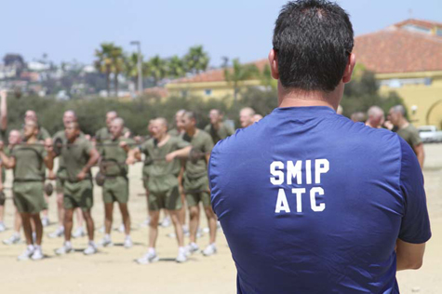

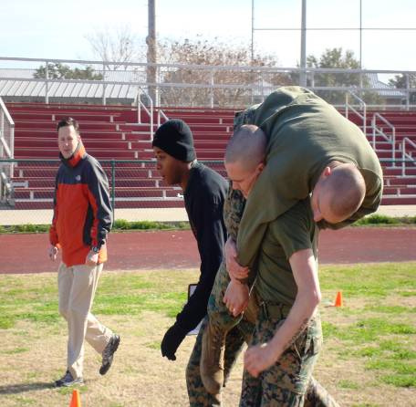
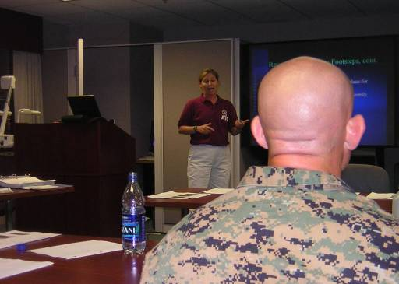
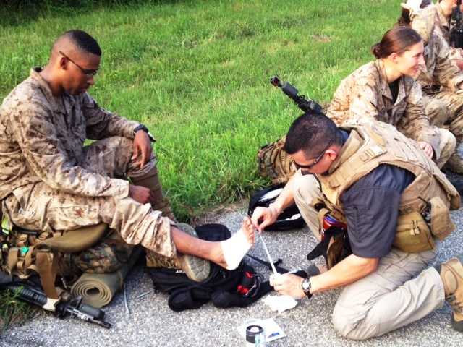

4 November 2011
Marines now treat boot camp injuries instead of dismissing them:
“To reduce injuries, the Corps has hired certified athletic trainers — most with experience tending professional and college athletes — to oversee training. It's a big change from the old ways.”
11 June 2012
Athletic trainers eyed for infantry battalions
10

Slide 11
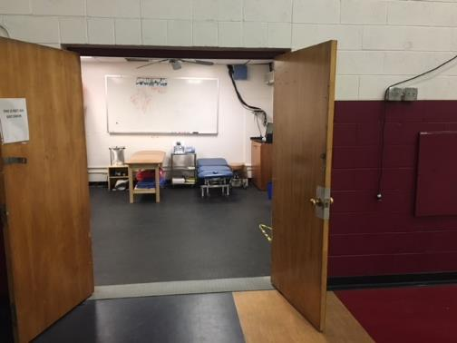
AT Room Example
ATR location in 29 Palms Gym

Slide 12
SMIP Policy
CG TECOM / Navy Surgeon General MOA
  Original MOA signed in October 2007
  Renewed in November 2012
  Covers entry level training
TECOMO 6260 w/ CH 1 USMC Sports Medicine and Injury Prevention Program
  Originally signed in 2008, CH 1 in 2012
OPNAVINST/MCO 6400.2 Scope, Limitations, Certification, Utilization and Oversight of Certified Athletic Trainers
  Co-signed 25 Jan 2017 by DC CD/I and Navy Surgeon General
  Modeled after Independent Duty Corpsman Instruction and TECOM SMIP Order
  Sets foundation for SMIP expansion to operating forces

Slide 13
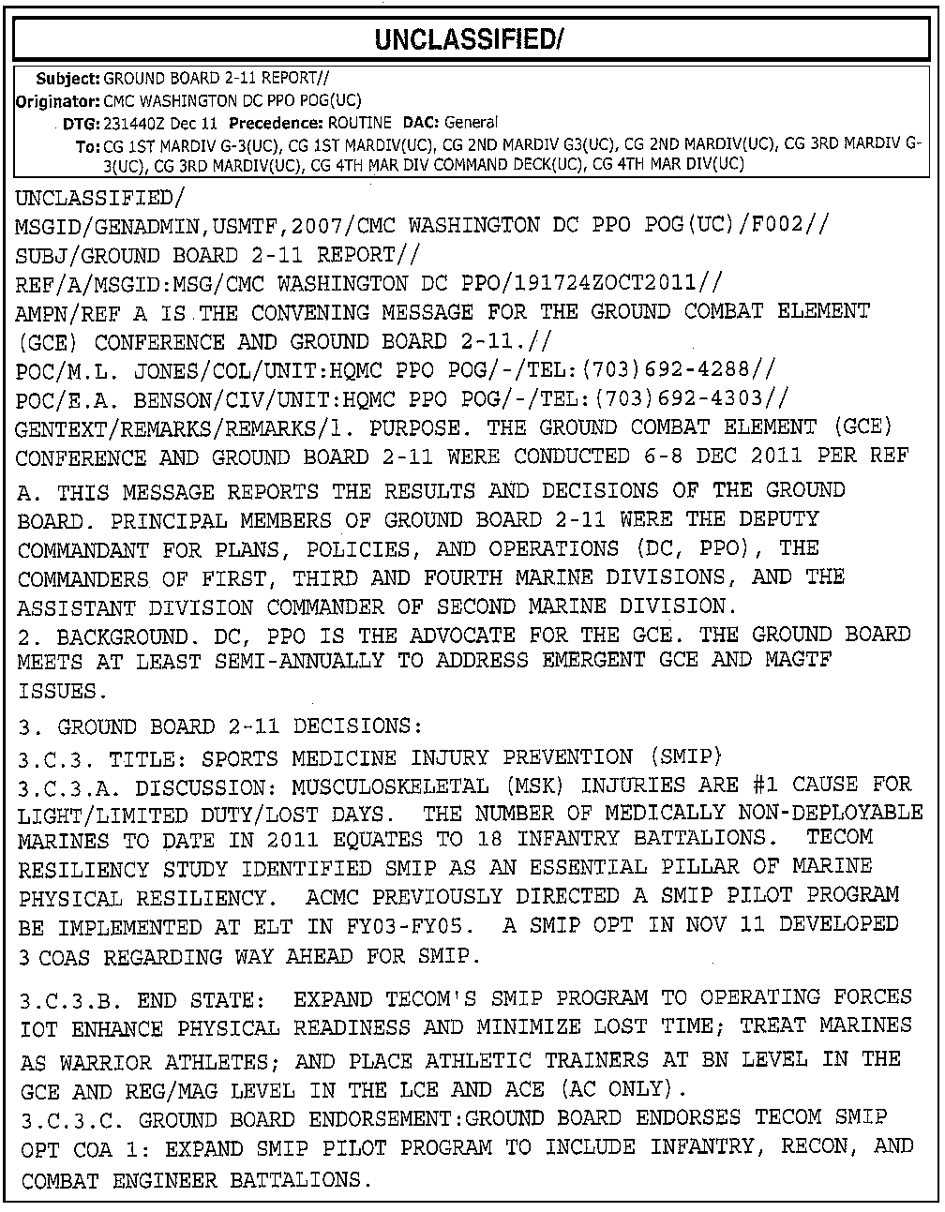

SMIP Expansion to Operating Forces
Ground Board 2-11
Report
-Ground Board endorses
expansion of SMIP to
Operating Forces
-Funded in POM-14 Baseline
-Cut in POM-15 due to
Sequestration
-Demand signal remains
especially in III MEF

Slide 14
AT OPFOR Expansion
(CMC directed distribution plan)
 |  | End FY 19 | END FY20
 |  | 33 | 66
 | Unit | Number of ATCs
I MEF | I MIG | 1 | 2
 | 1ST MARINES | 1 | 2
 | 5TH MARINES | 1 | 2
 | 7TH MARINES | 1 | 2
 | 11TH MARINES | 1 | 2
 | HQTRS REGT
 | CLR-1 | 1 | 2
 | CLR-15 | 1 | 2
 | MAG-11 | 1 | 2
 | MAG-13 | 1 | 1
 | MAG-16 |  | 1
 | MAG-39 |  | 1
 | MACG-38 |  | 1
II MEF | II MIG | 1 | 2
 | 2D MARINES | 1 | 2
 | 6TH MARINES | 1 | 2
 | 8TH MARINES | 1 | 2
 | 10TH MARINES | 1 | 2
 | HQTRS REGT, 2D MLG
 | CLR-2 | 1 | 2
 | CLR-25 | 1 | 2
 | MAG-14 | 1 | 2
 | MAG-26 | 1 | 1
 | MAG-29 |  | 1
 | MAG-31 |  | 1
 | MACG-28 |  | 1
III MEF | III MIG | 2 | 4
 | 3D MARINES | 2 | 3
 | 4TH MARINES | 3 | 5
 | 12TH MARINES | 2 | 2
 | HQTRS REGT, 3D MLG
 | CLR-3 | 1 | 1
 | CLR-35 | 1 | 1
 | MAG-12 | 1 | 1
 | MAG-24 | 1 | 1
 | MAG-36 | 1 | 1
 | MACG-18 | 1 | 1
ELT | RTR, MCRD PI |  | 1
 | RTR, MCRD SD |  | 1
 | SOI EAST, MCB CAMP LEJ |  | 1
 | SOI WEST, MCB CAMP PEN |  | 1
 | MARDET FT. LEONARDWOOD
 | MATSG-23, NAS PENSACOLA
 | MCCES (COMM/ELEC SCHOOL 29 PALMS) |  | 1
 | MCCSSS |  | 1
 | MCES
 | MARDET FT. SILL
 | COST | 4.5M | 8.6M
NOTES:
-Distribution prioritizes supporting more units, but with AT ratio of 1 to 2000-3000 Marines
-Chart does not reflect current AT numbers at ELTs
 | AT/Marines
 | 1/1000
 | 1/2000-3000
 | 0

